Slide 1
STA 101 Final Project
Group 4 - Plant Pals
Liu M, Feng Z, Zhang Z, Ma C, Wang M, et al. (2017) Development and evaluation of height diameter at breast models for native Chinese Metasequoia. PLOS ONE 12(8): e0182170. https://doi.org/10.1371/journal.pone.0182170

Slide 2
Development and evaluation of height diameter at breast models for native Chinese Metasequoia
About the Paper
Trying to predict the growth of Metasequoia trees through the relationship between height and diameter
Examination of several different models and variables to see which model or variable has the most predictive power regarding growth
53 total models: 7 linear and 46 non-linear
2 model groups: group 1 has one variable (dbh) group 2 had multiple variables
Reason: measuring height of individuals trees can be tricky and expensive
Variables
h: height of the tree in meters
dbh: diameter at breast height in centimeters
BA: basal area in cm²
ASL: above sea level in meters
T: age of the stand in years
H₀: dominant height of the stand in meters
D₀: dominant dbh of the stand in centimeters

Slide 3
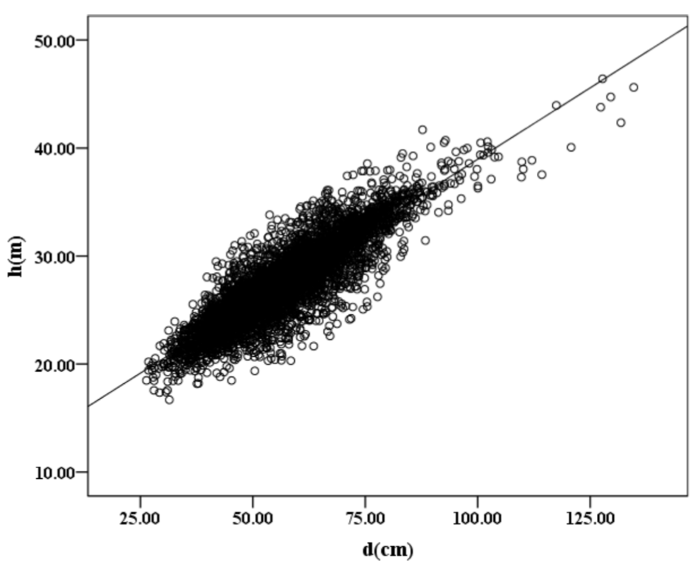
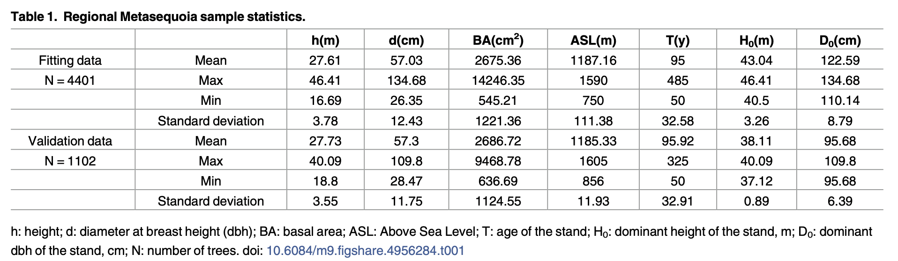
Data Observation
Fitting data - used to make and fit models
Validation data - used to check predictive power of models

Slide 4
Data Comparison
Paper’s Data
5746 observations (reduced to 5503)
divided into fitting data (4401 observations) and validation data (1102 observations)
Many variables:
height (h)
diameter (dbh)
basal area (BA)
above sea level (ASL)
age of the stand (T)
dominant height of the stand (H₀)
dominant dbh of the stand (D₀)
Our Data
500 observations
Two variables:
height
diameter

Slide 5
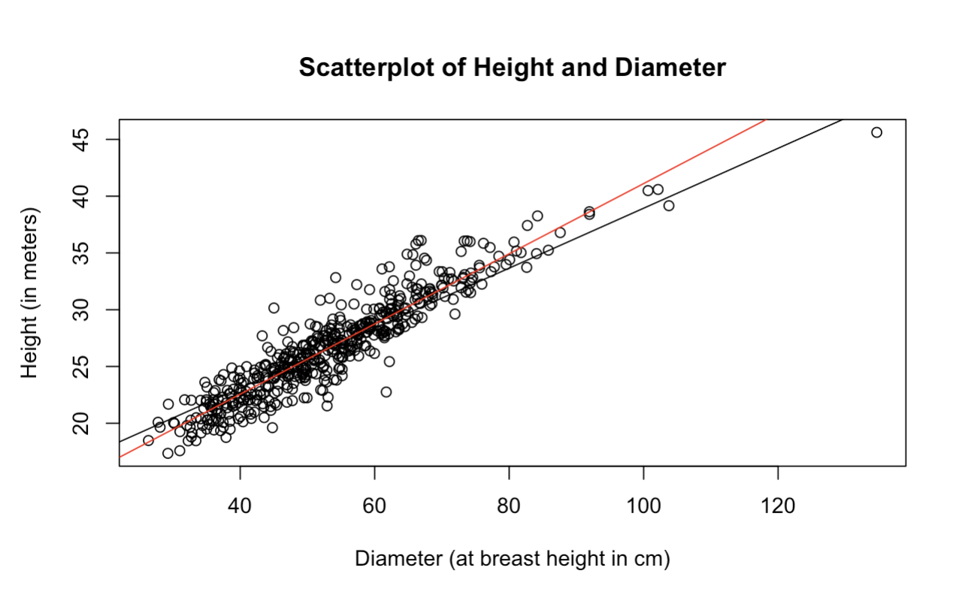
Data Comparison
 | Paper’s Data (Fitting Data) n = 4401 | Paper’s Data (Validation Data) n = 1102 | Our Data n = 500
Mean Height | 27.61 | 27.73 | 26.69130
Max Height | 46.41 | 40.09 | 45.62
Min Height | 16.69 | 18.8 | 17.35
SD Height | 3.78 | 3.55 | 4.44614
Mean Diameter | 57.03 | 57.3 | 53.36036
Max Diameter | 134.68 | 109.8 | 134.68
Min Diameter | 26.35 | 28.47 | 26.35
SD Diameter | 12.43 | 11.75 | 13.33801
Red Line: Trendline for Our Data (Model 1)
Black Line: Trendline for Paper’s Data

Slide 6
Replication Process
Testing Group 1 Linear Models:
Group 1: single variable models
 | General Model | Our Model
Model 1 | h = β₀ +β₁d | h = 10.1942 + 0.3092d
Model 2 | h = β₀ +β₁log(d) | h = -39.31 + 16.72log(d)
Model 3 | h = β₀ +β₁d+β₂d² | h = 7.4610696 + 0.4066729d -0.0008166d²
Model 4 | h = β₀ +β₁d²+β₂d³ | h = 15.75 + 0.005308d² -0.00002802d³
Model 5 | h = β₀ +β₁d⁻¹+β₂d² | h = 30.73 - 411.7d⁻¹ -0.001373d²

Slide 7
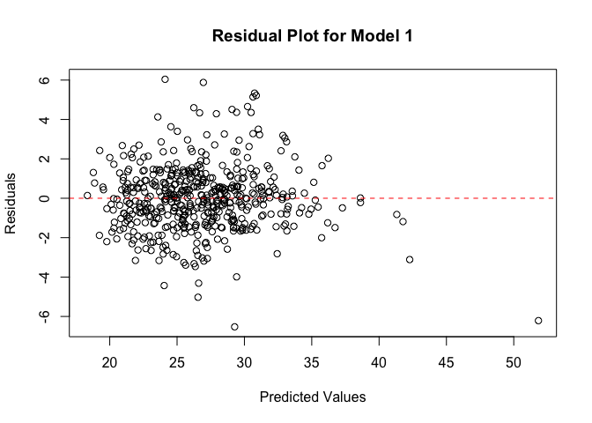
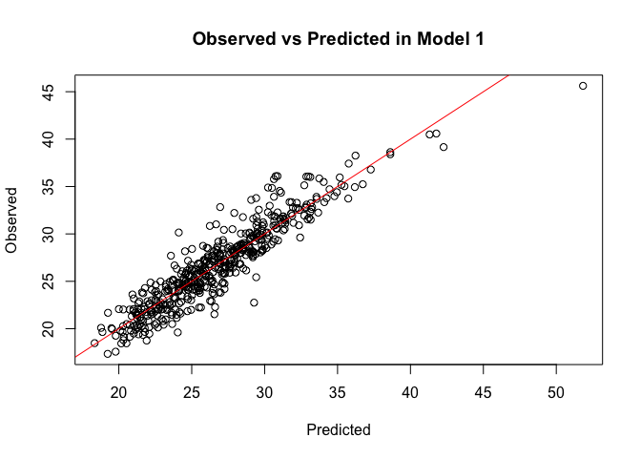
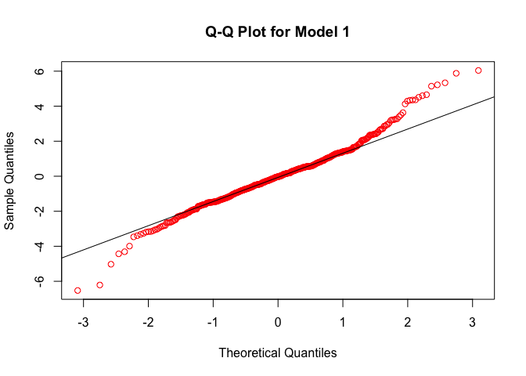
Model 1

Slide 8
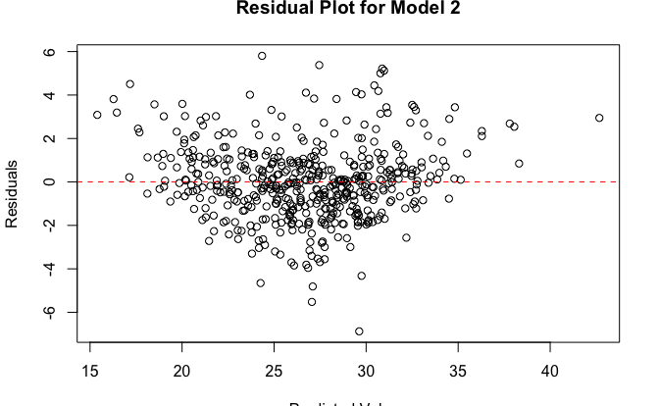
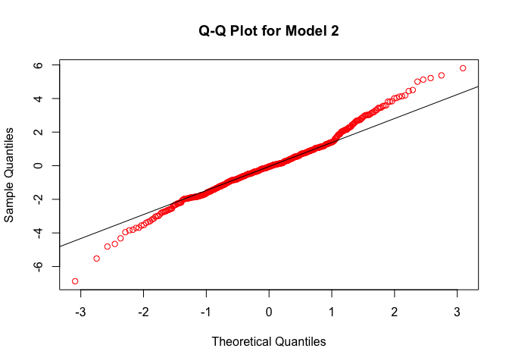
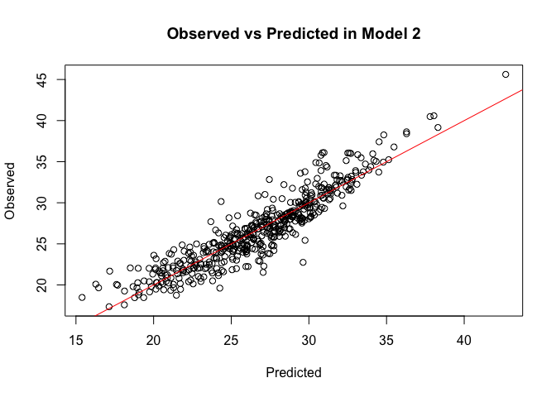
Model 2

Slide 9
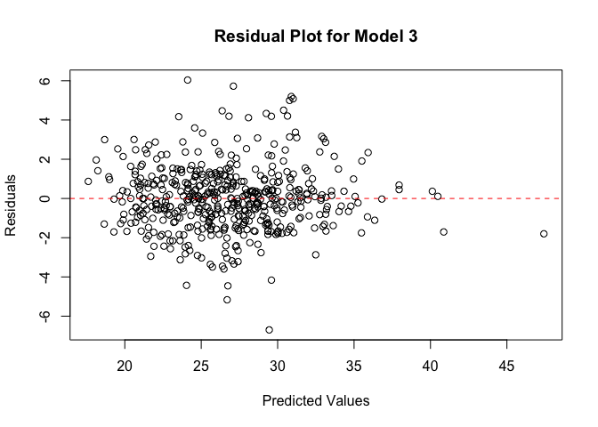
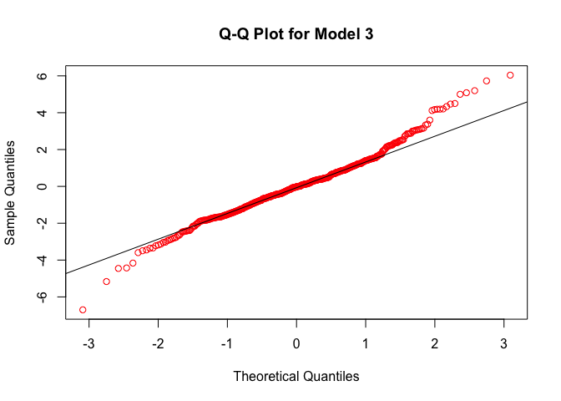
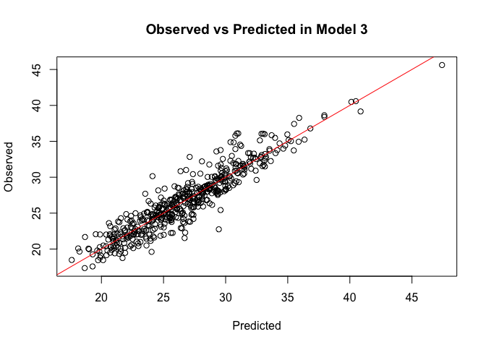
Model 3

Slide 10

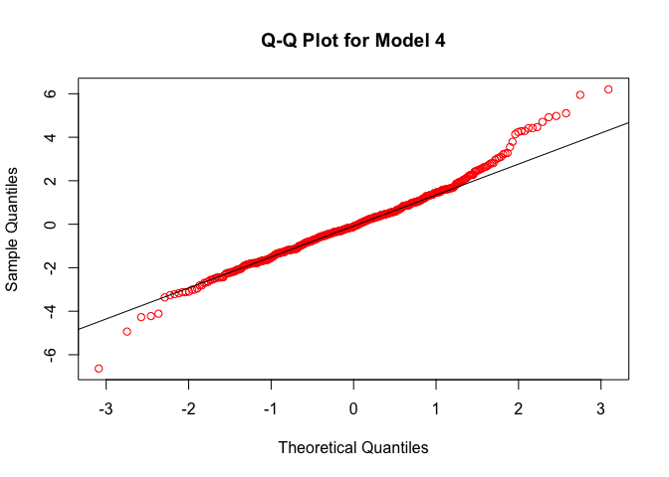
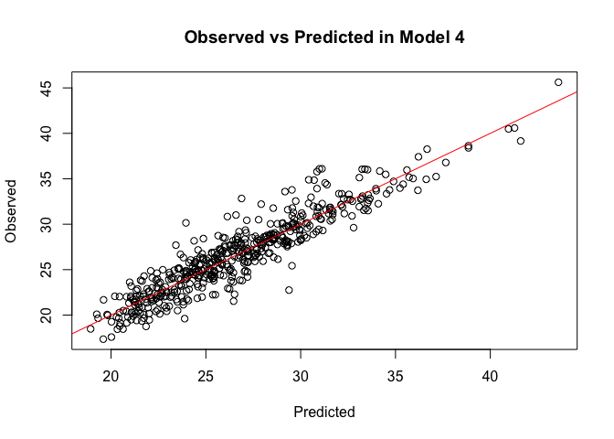
Model 4

Slide 11
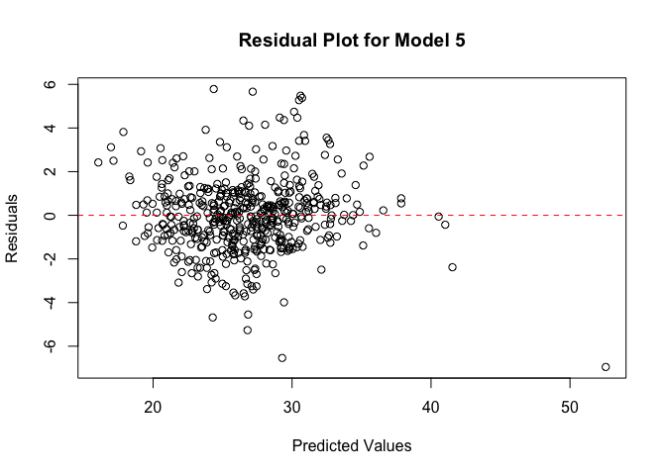


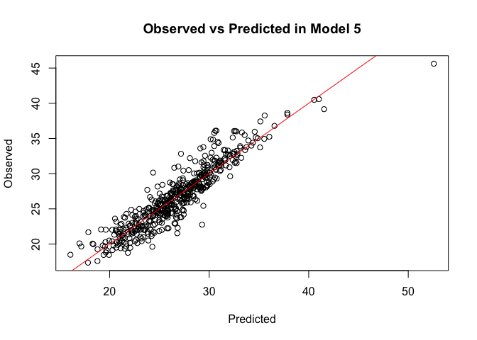
Model 5

Slide 12
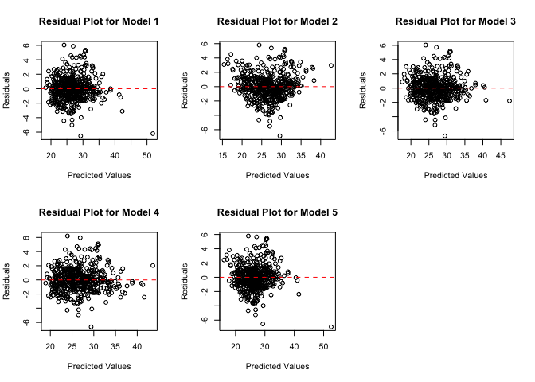
Residual Plot
Comparison

Slide 13
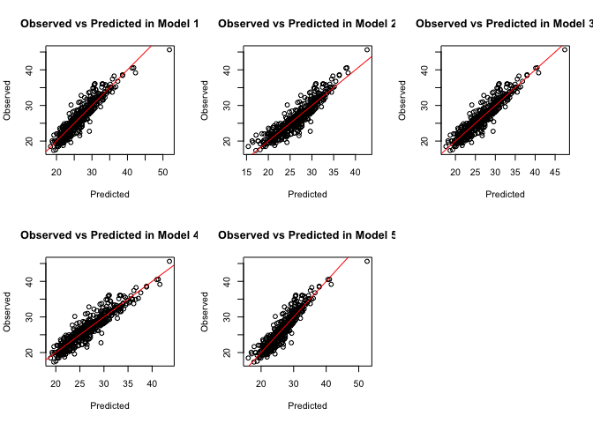
Observed vs
Predicted Plot
Comparison

Slide 14
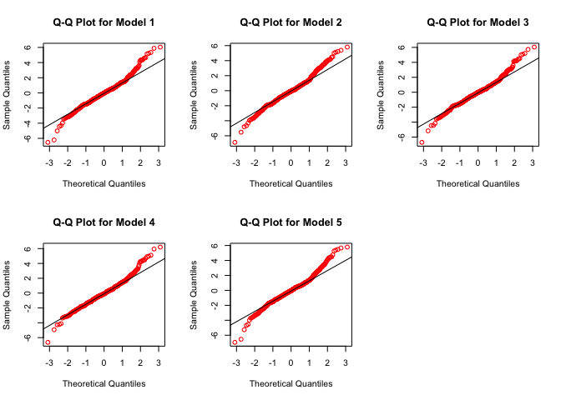
Q-Q Plot
Comparison

Slide 15
Model Diagnostics
Comparison
 | RMSE | R²_{adj} | AIC | Bias
Model 1 | 1.66083 | 0.8599043 | 1932.256 | 0.0000
Model 2 | 1.739887 | 0.8462496 | 1978.759 | 0.0000
Model 3 | 1.635669 | 0.8638436 | 1918.99 | 0.0000
Model 4 | 1.631005 | 0.8646189 | 1916.135 | 0.0000
Model 5 | 1.70729 | 0.8516588 | 1961.846 | 0.0000
*Bias values were found to be extremely small, and therefore not significant

Slide 16
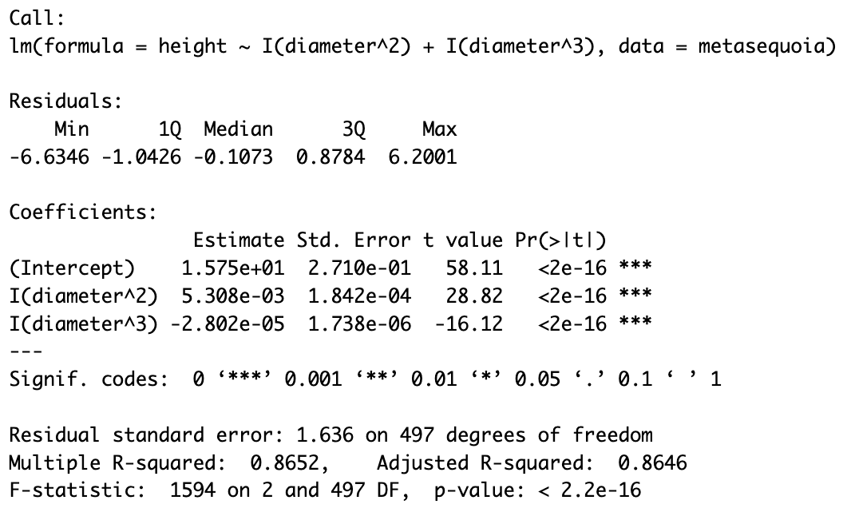
Final Selection: Model 4
CI for Betas:
B0 (Intercept): (15.21801e+01, 16.28303)
B1 (diameter^2): (0.004946444, 0.005670146)
B2(diameter^3): (-0.00003143211, -0.00002460142)

Slide 17
Model 4 Interpretation
β0: We cannot interpret the intercept, as a tree cannot have a dbh of 0.
β1: As the (dbh)² of a Chinese Metasequoia tree increases by 1 cm, we expect the height of the tree to increase by 0.005308 meters on average.
β2: As the (dbh)³ of a Chinese Metasequoia tree increases by 1 cm, we expect the height of the tree to decrease by 0.00002802 meters on average.

Slide 18
Model 4 Interpretation
β1: We are 95% confident that as the (dbh)² of a Chinese Metasequoia tree increases by 1 cm the height of the tree will increase by between 0.004946444 meters and 0.005670146 meters.
β2: We are 95% confident that as the (dbh)³ of a Chinese Metasequoia tree increases by 1 cm the height of the tree will decrease by between 0.00003143211 meters and 0.00002460142 meters.

Slide 19
Findings: Comparison with Paper
From the 5 linear models we replicated, we found Model 4 to be the best fit.
Our findings align with the findings of the paper, where Model 4 was their best fit linear model.
 | RMSE | R²_{adj} | Bias
Our Model 4 | 1.631005 | 0.8646189 | 0.0000
Paper’s Model 4 | 1.8277 | 0.7583 | 0.0000

Slide 20
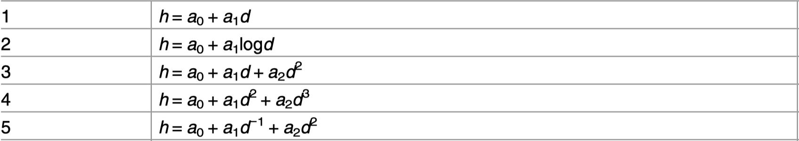
Exploratory Analysis
Didn’t have a complete dataset.
Didn’t fully explain why these explanatory variables are included in these models

Slide 21
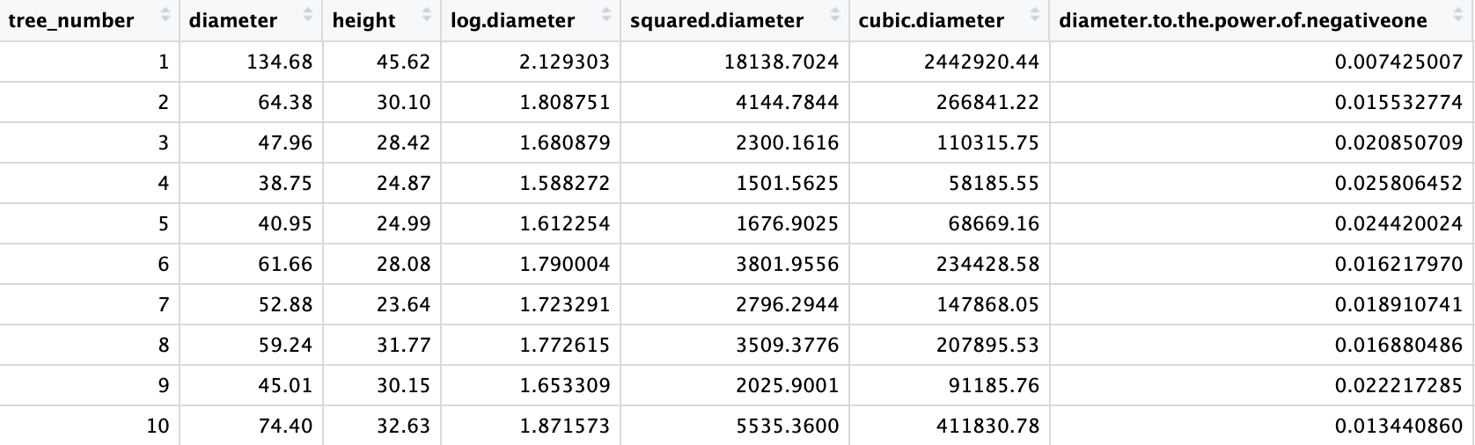
Data Processing
X₁ -> d; X₂ ->d²; X₃ -> d³; X₄ -> log(d); X₅ -> d⁻¹
h =β₀ + β₁X₁+β₂X₂+β₃X₃+ β₄ X₄+ β₅X₅ (Multiple linear regression)

Slide 22
Stepwise Selection
Forward/Backward/Forward-Backward/Backward-Forward
AIC/BIC
AIC: Backward AIC Model: 1912.894; Model4: 1916.135
BIC: Forward BIC Model: 1932.985; Model4: 1932.994
Backward Model = Model A; Forward Model = Model B; Model 4 = Model C

Slide 23
Removing Outliers
Model | P-values of SW Test (Before) | P-values of SW Test (After)
Model A | 2.051e-06 | 0.1147
Model B | 1.835e-06 | 0.06006
Model C | 2.871e-06 | 0.2097

Slide 24
Evaluation
Model | AIC | BIC | RMSE | Adjusted R²
Model A* | 1629.31 | 1650.148 | 1.321083 | 0.9077727
Model B* | 1608.176 | 1624.821 | 1.30867 | 0.9093569
Model C* | 1632.427 | 1649.098 | 1.328188 | 0.9032784

Slide 25
Best Model Based On the 500 Data
Model B:
Y = 8.659 + 0.3496X₁ -3.763x10⁻⁶ X₃
Y = 8.659 + 0.3496x -3.763x10⁻⁶ x³
βs | 95% CI | t-statistics | p-values
β₀ | (7.8401, 9.4784) | 20.771728 | 1.648354e-68
β₁ | (0.3299, 0.3693) | 34.862165 | 1.530932e-132
β₃ | (-5.276*10⁻⁶, -2.249*10⁻⁶) | -4.885436 | 1.416719e-06

Slide 26
Model B Interpretation
β0: We cannot interpret the intercept, as a tree cannot have a dbh of 0.
β1: As the dbh of a Chinese Metasequoia tree increases by 1 cm, we expect the height of the tree to increase by 0.3496 meters on average.
β2: As the (dbh)³ of a Chinese Metasequoia tree increases by 1 cm, we expect the height of the tree to decrease by 0.000003763 meters on average.

Slide 27
Model B Interpretation
β1: We are 95% confident that as the dbh of a Chinese Metasequoia tree increases by 1 cm the height of the tree will increase by between 0.3299 meters and 0.3693 meters.
β2: We are 95% confident that as the (dbh)³ of a Chinese Metasequoia tree increases by 1 cm the height of the tree will decrease by between -5.276*10⁻⁶ meters and -2.249*10⁻⁶ meters.

Slide 28
Overall Findings
Overall, we found that out of the 5 linear models proposed in the paper Model 4 was the best fit for the data
This is in alignment with what the paper found, as they found Model 4 to be the best fit as well
Although Model 4 was the best fit out of the 5 proposed models, we found Model B (our Forward BIC Model) to be a better fit for the our data
Due to the limitation of the incomplete dataset, Model B might not be the best model under the full dataset

Slide 29
Challenges
Limited dataset
Only one explanatory variable, so we had very limited number of potential model
We were unable to determine if our final model is the best fit for the full dataset, or just our smaller dataset as the model was not tested in the paper

